Slide 1
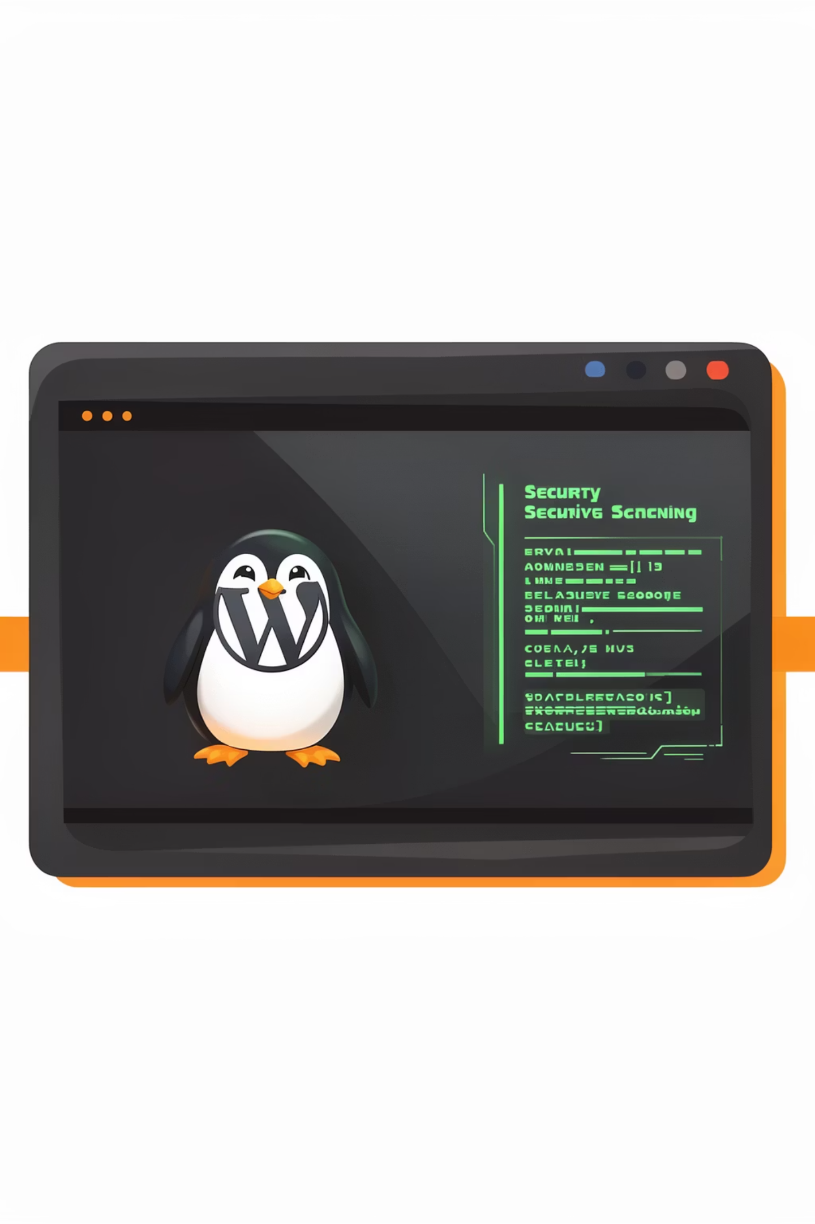
WPSCAN
WPScan is a WordPress vulnerability scanner that identifies security issues in WordPress installations.

Slide 2




Where to Use?
WordPress security auditing
Finding vulnerable plugins/themes
Checking for outdated WordPress versions
Finding weak passwords

Slide 3
Installation & Basic Syntax
Installation
Basic Syntax
sudo apt install wpscan # Kali/Debian
brew install wpscan # macOS
wpscan [options] [target]

Slide 4
Practical Examples
1. Basic WordPress Scan
# Basic scan
wpscan --url http://192.168.1.105
# Output:
# [+] WordPress version 5.8.2 identified
# [+] WordPress theme: twentytwentyone
# [+] WordPress plugin: akismet
# [+] WordPress plugin: contact-form-7
# [+] WordPress plugin: wp-super-cache
# [+] WordPress user: admin
# [+] WordPress user: john
# [+] WordPress user: jane
2. Detailed WordPress Scan
# Scan with all options
wpscan --url http://192.168.1.105 --enumerate p,t,u
# -p = plugins
# -t = themes
# -u = users
# Scan with specific plugins
wpscan --url http://192.168.1.105 --plugins-detection=aggressive
# Scan with specific themes
wpscan --url http://192.168.1.105 --themes-detection=aggressive
# Scan with specific users
wpscan --url http://192.168.1.105 --users=admin,john,jane

Slide 5
3. Brute Force WordPress Login
Brute force login
Brute force all users
Use specific wordlist
wpscan --url http://192.168.1.105 --passwords /usr/share/wordlists/rockyou.txt --username admin
wpscan --url http://192.168.1.105 --passwords /usr/share/wordlists/rockyou.txt --usernames=admin,john,jane
wpscan --url http://192.168.1.105 --passwords /usr/share/wordlists/rockyou.txt --username admin --threads 10

Slide 6
4. Real-World Scenario
01
02
Basic scan
Enumerate plugins
wpscan --url http://192.168.1.105
wpscan --url http://192.168.1.105 --enumerate p
03
04
Enumerate themes
Enumerate users
wpscan --url http://192.168.1.105 --enumerate t
wpscan --url http://192.168.1.105 --enumerate u
05
06
Check for vulnerable plugins
Check for vulnerable themes
wpscan --url http://192.168.1.105 --plugins-detection=aggressive
wpscan --url http://192.168.1.105 --themes-detection=aggressive
07
08
Brute force login
Save results
wpscan --url http://192.168.1.105 --passwords /usr/share/wordlists/rockyou.txt --username admin
wpscan --url http://192.168.1.105 --enumerate p,t,u --output-file results.txt

